Slide 1
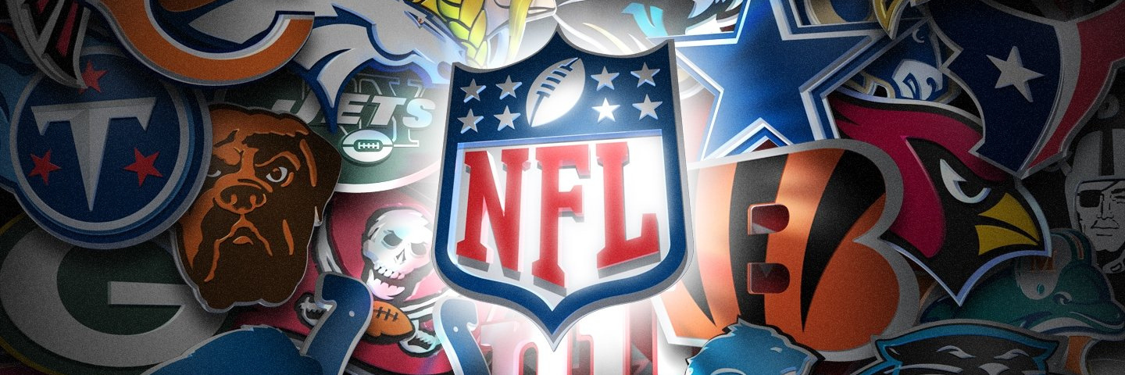
PREDICTING THE NFL GAME WINNER
Group 1
FINAL PROJECT

Slide 2




OUR TEAM
Samuel Kuczynski
Samuel Aboma
Felipe Serrano
Vytas Stuopis

Slide 3

Topic Discussion
Technologies Used
Questions to be Answered
Data Discussion
Model Discussion
Data Visualization
Questions
AGENDA

Slide 4
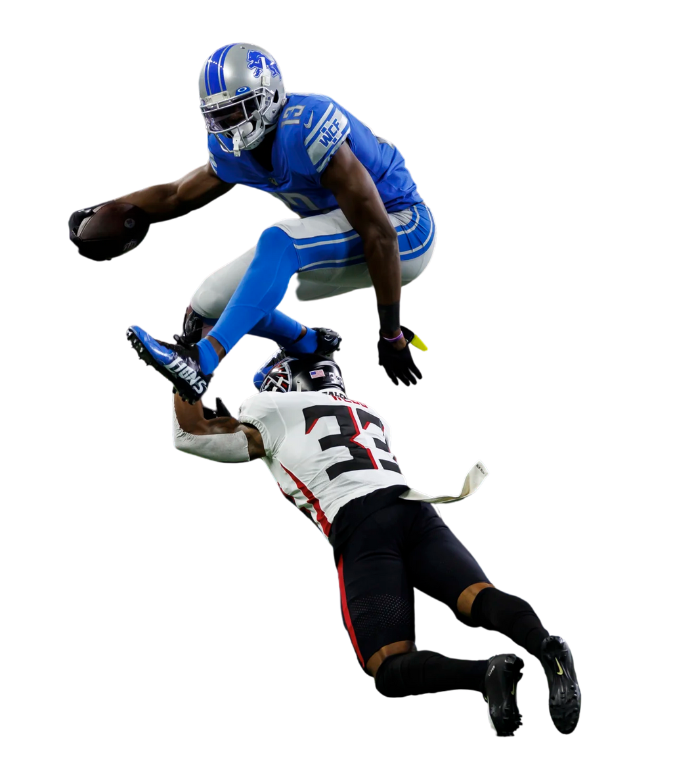
Topic Discussion - Popularity
NFL is one of the most popular American sports with billions of dollars spent on it. NFL's popularity starts from childhood, where kids grow up playing the sport and idolizing their favorite athlete.
Even as adults, NFL continues to be a popular pastime, with Sunday traditions and international games.
NFL's popularity extends beyond traditional viewership to betting, including daily fantasy sports.
NFL's popularity and market reach make it an exciting industry to apply machine learning models to.

Slide 5
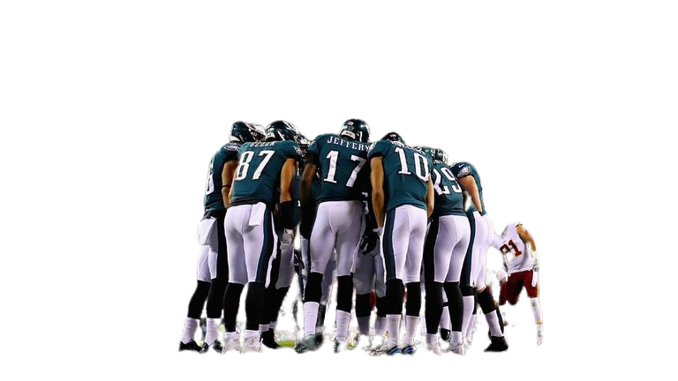

TOPIC DISCUSSION –
KEYS TO THE GAME
Strategy is a key element in NFL, with data analytics playing an increasing role in play designs.
Coaches' preparation and scouting impact the game, including film study during off-season and identifying opponent's weakness.
Additional data points and technology provide a competitive advantage.
Team strengths should be taken advantage of to succeed, such as offensive line run blocking or strong pass rush.

Slide 6






























TECHNOLOGIES USED
Open ML
Data Source
Quick DBD
ERD Diagram Creation
Python
Data Cleaning
Machine Modeling
AWS
Server
PG Admin
SQL
Tableau

Slide 7
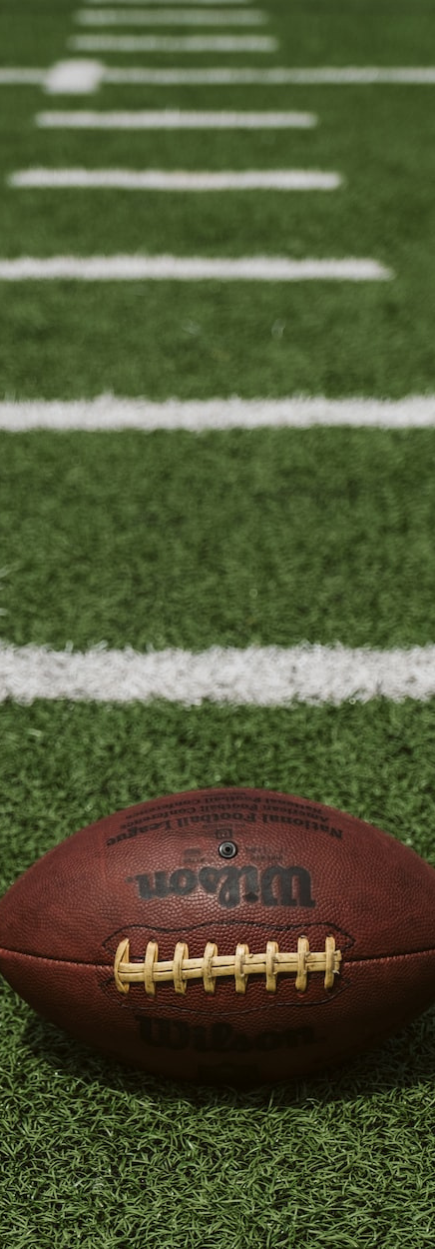
Questions We Will Be Answering
"Photos are a reflection of a story and full of meaning."
Can we create a machine learning model to analyze key metrics' impact on winning NFL games?
What specific statistics will be used to train this model?
How do these statistics play a major part in winning football games?
Can teams that rank high in these statistics win more playoff games and Super Bowls?
Will this model provide ideal targets for these statistics to help teams win games on any given Sunday?

Slide 8
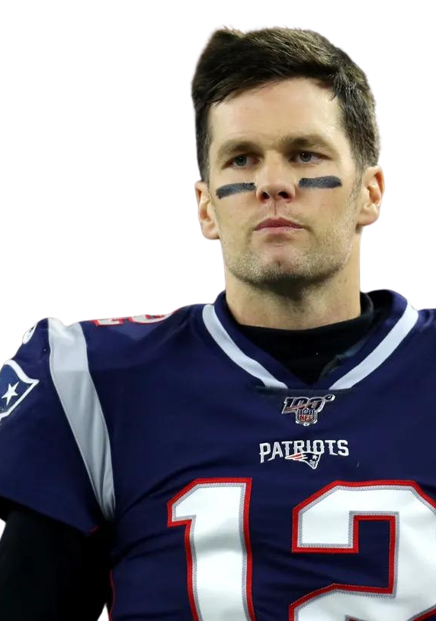
What key metrics a team needs to meet to be the winner of NFL game
01
Point Scored Diffrential
02
03
Turn Over Diffrential
Time Of Posstion
WINNER

Slide 9

DATA DISCUSSION
OUR DATA SET CONSISTS OF NFL GAME STATISTICS FROM 2002 TO 2022 SCRAPED FROM ESPN TEAM STATES PAGE.
The data set includes 256 regular season games and 11 playoff games per year.
Three games were missing from all seasons and not included in the data set.
The statistics recorded for each game include general game information such as the date, home team, away team, and score.
Offensive statistics include efficiency on first, third, and fourth downs, passing yards, completion attempts, rushing yards and attempts, red zone statistics, and time of possession.
Defensive statistics include sacks, turnovers, and defensive touchdowns.
General statistics
Offensive statistics
Defensive statistics
1
2
3
Efficiency on first, third and fourth downs, Passing yards, Completion attempts, Rushing
yards & attempts, Redzone statistics, Time of possession
Date of the game, Home Team, Away Team, Date of the game, Score
include sacks, turnovers, and defensive touchdowns.

Slide 10

DATA EXPLORATION
In this project, we aim to predict the winner of NFL games based on certain features such as
turnovers, score, possession, and home advantage. The dataset used in this project is
contained in the 'final_nfl_data.csv' file. We started by importing the necessary libraries such as
NumPy, Pandas, Pathlib, and collections. We also imported the required methods from
Scikit-learn and imblearn libraries such as balanced_accuracy_score, confusion_matrix, and
classification_report_imbalanced.
After importing the necessary libraries and methods, we loaded the dataset into a Pandas
dataframe using the read_csv method. We then checked the dataset for any null values, and
dropped the null columns and rows using the dropna method. We also reset the index of the
dataframe using the reset_index method. Since we would not be using the 'date', 'team_id', and
'name' columns in the prediction, we dropped them using the drop method.
To gain insights into the data, we printed the description of the features using the describe
method to get a statistical summary of the data. Overall, the data exploration phase of this
project involved loading the dataset into a Pandas dataframe, checking for null values,
dropping irrelevant columns, and creating the features and target variables for the model.
Loading the dataset
Data cleaning
creating target variables

Slide 11
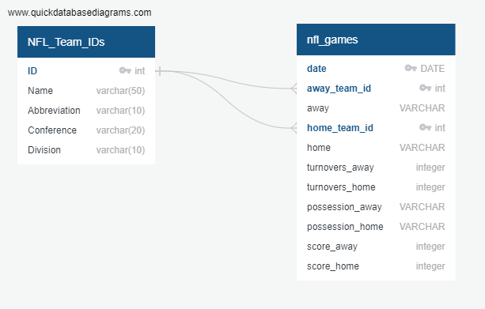
EDR DIAGRAM

Slide 12

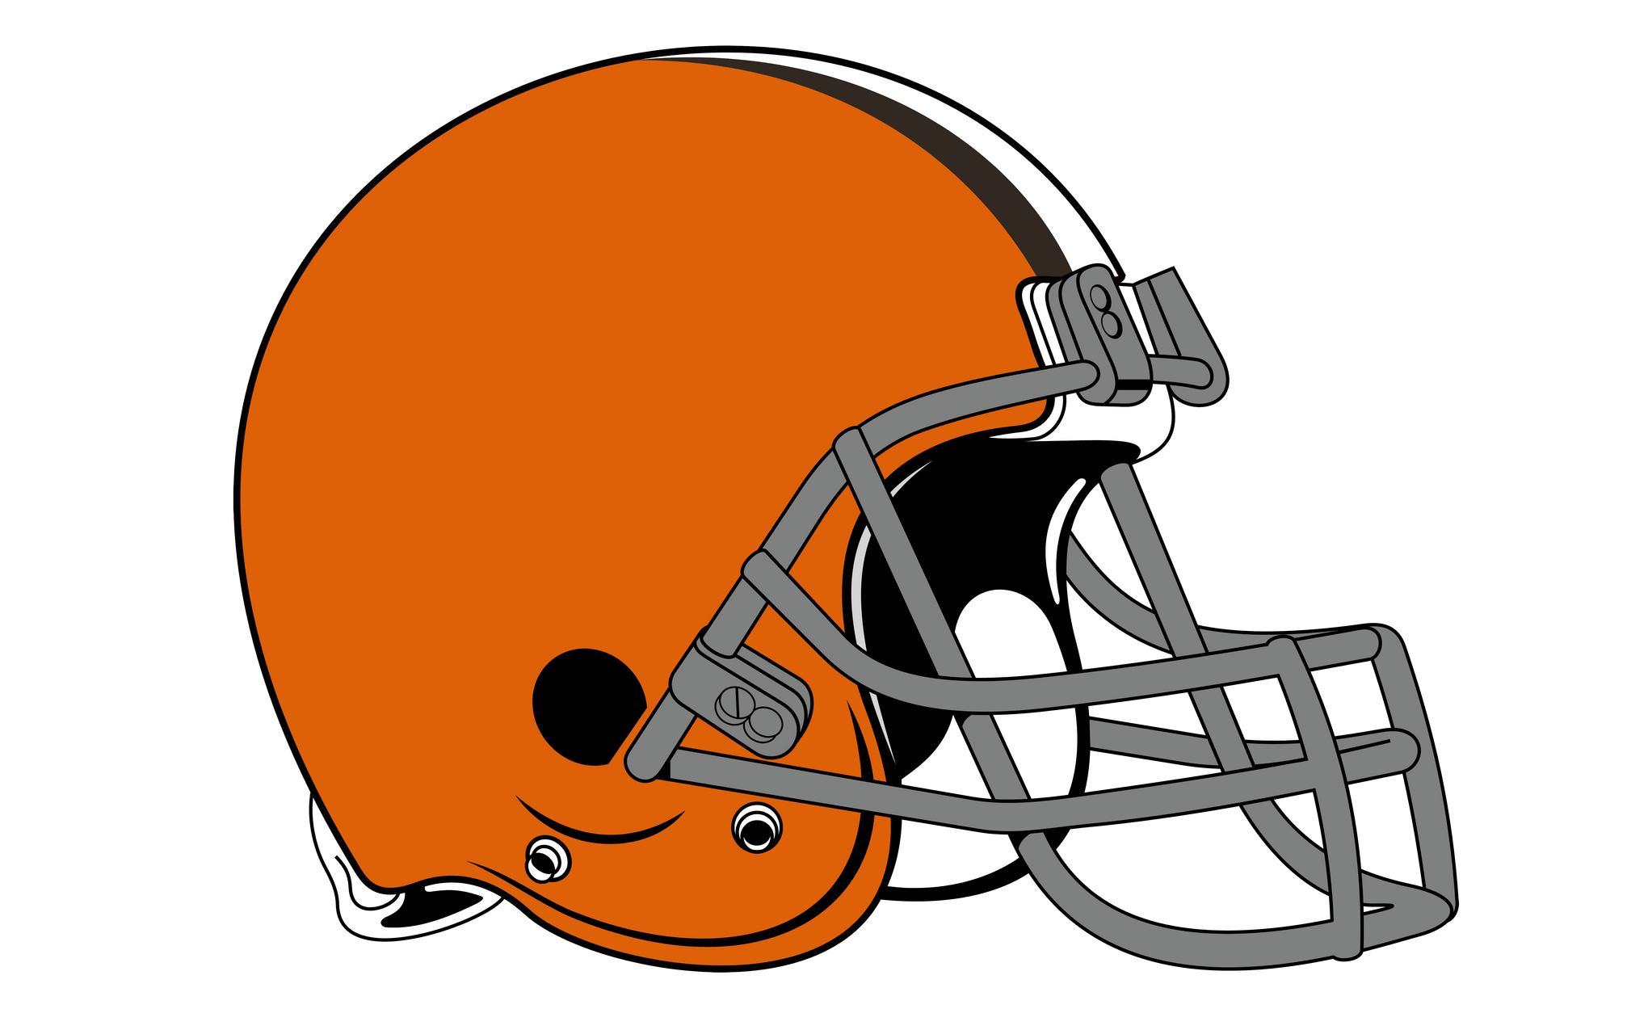
PROJECT
ANALYSIS PHASE
Cleaned data by dropping null columns and rows, removing irrelevant columns, and converting possession to seconds
Split data into training and testing datasets (80% for training)
Normalized features using StandardScaler
Fitted a decision tree classifier model and evaluated performance using confusion matrix, accuracy score, and classification report
Achieved 72.98% accuracy score with room for improvement
Implemented regression model to enhance accuracy to roughly 81.37%
The model has shown promising results in predicting the winner of NFL games.

Slide 13



MODEL DISCUSSION
The Ability to Predict The winner
Resources
Technology
Service
DATA
Machine Learning
Predict Game Winner

Slide 14

MODEL DISCUSSION
Decision Tree Classifier:
A type of supervised learning algorithm that can be used for both classification and regression tasks.
It builds a model in the form of a tree with nodes and branches based on the training data, where each node represents a feature and each branch represents a decision or outcome.
Logistic Regression:
A statistical model that is commonly used for classification tasks.
It works by modeling the probability of an event occurring, given a set of features, and classifies the event as either 0 or 1 based on a threshold probability.

Slide 15
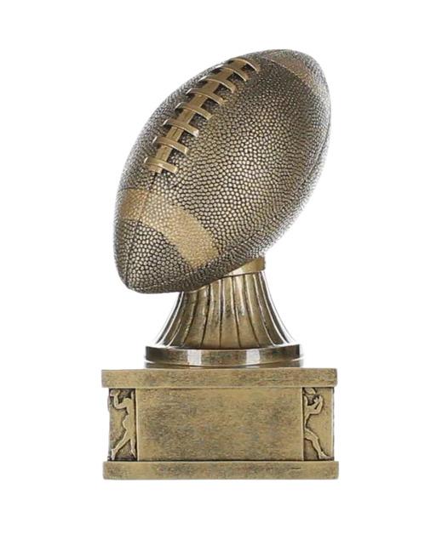
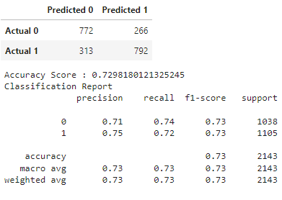
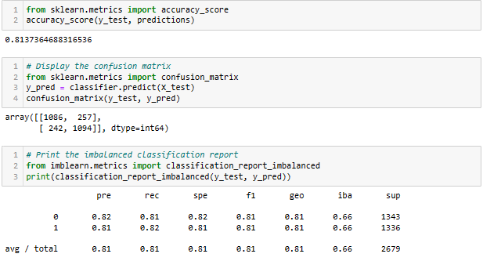
Decision Tree
Logistical Regression
Was the model successful?

Slide 16

OTHER MODEL ONE COULD USE ?
There are many other models that can be used for predicting the winner of NFL games. Some examples include:
Neural Networks: A class of models inspired by the structure and function of the human brain, often used for complex and non-linear classification problems. (Module 20)
Gradient Boosting: A machine learning technique that combines multiple weak models to create a strong predictive model.
Bayesian Networks: A probabilistic graphical model that uses a network of nodes and edges to represent the relationship between different variables.
The choice of model depends on the specific problem, the amount and quality of available data, and the desired level of accuracy and interpretability.

Slide 17
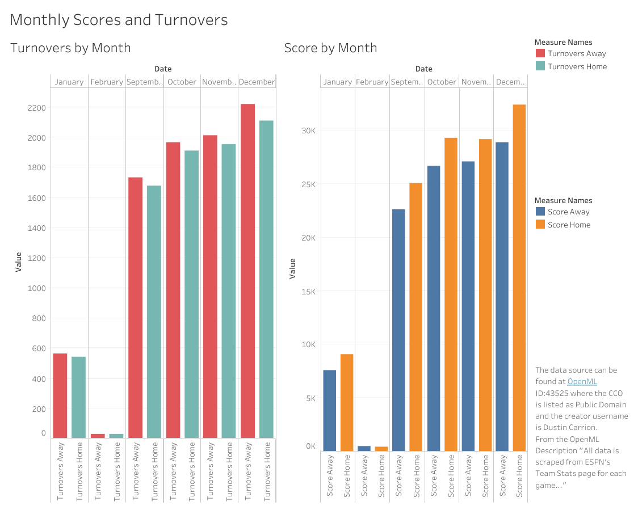
DATA VISUALAIZATION
https://public.tableau.com/app/profile/vytas.stuopis/viz/NFLG
ameData_16803752169090/Dashboard1

Slide 18
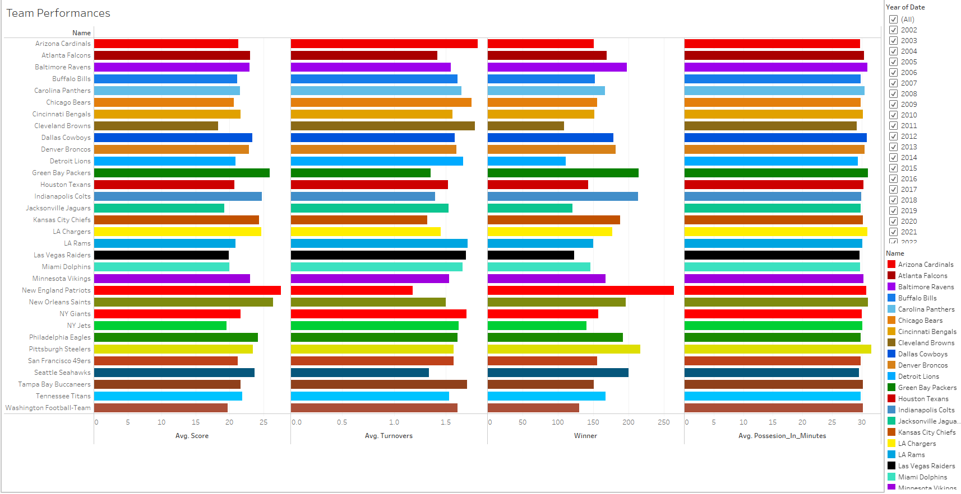
DATA VISUALAIZATION
https://public.tableau.com/app/profile/samuel.kuczynski/viz/Final_Project_16807594084690/Dashboard1?publish=yes

Slide 19
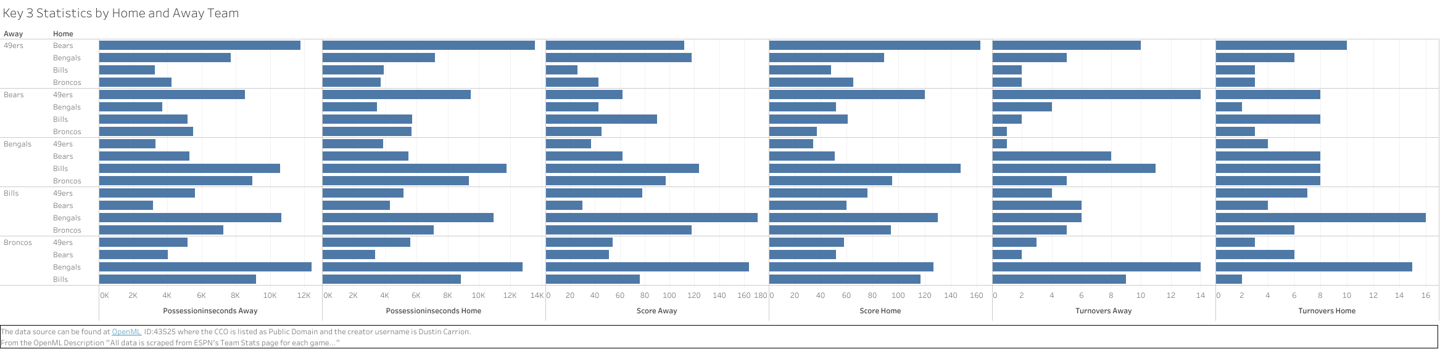
DATA VISUALAIZATION
https://public.tableau.com/app/profile/vytas.stuopis/viz
/NFLTeamStats_16806554198700/AllStatsbyHomean
dAwayTeam

Slide 20
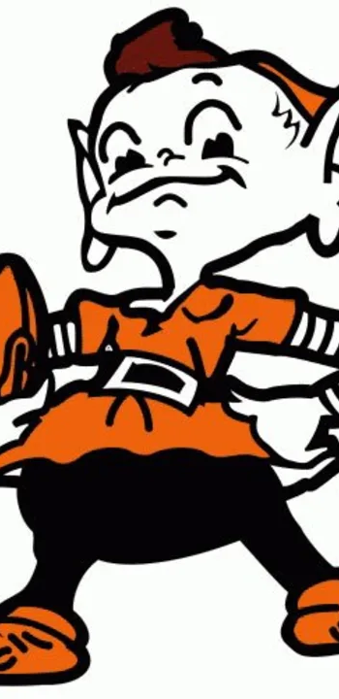
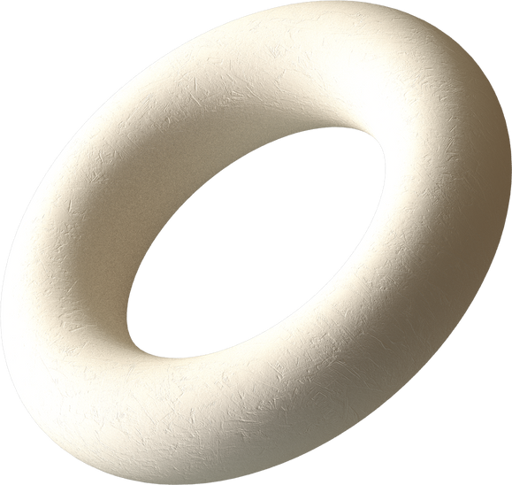
Do you have any questions?
We hope you learned something new.

